Slide 1
LSTM-based time series anomaly detection using Analytics Zoo for Spark and BigDL
Guoqiong Song, PhD., Deep Learning R&D Engineer
Notes:
This is Guoqiong Song from Intel, I am a deep learning engineer at Intel, it is an honor to be here to present our recent projects.

Slide 2
Agenda
Why deep learning
Analytics Zoo /BigDL on Apache Spark
Analytics Zoo solution
    Baosight
    TravelSky
Notebook using public data
Takeaways

Slide 3
Why deep learning for anomaly detection
Unsupervised learning
Traditional methodologies
  3 sigma-law
  KNN
  Kmeans
  L1-filtering
  …
Notes:
Given these time series data, we want to learn the patterns and predict the expected values, also detect anomalies. This is important in many emerging smart systems.
In terms of algorithms, traditionaly, we have 3 signma-law. Why do we need deep learning? The first reason is compared to traditional algorthims, Deep nueral networks learn non-linear relationship, but DNNS have so many parameters that it needs a lot of data to train it. Nowadays, we are able to collect and process massive time series data at scale in many emerging smart systems, such as logs, industrial, manufacturing, IoT. So DNNs are important now, We want to build deep neural networks at scale to learn the patterns and detect anomalies. I will showcase how to use LSTM to build a deep neural network, because it catches the memories.

Slide 4
Agenda
Why deep learning
Analytics Zoo/BigDL on Apache Spark
Analytics Zoo solution
    Baosight
    TravelSky
Notebook using public data
Takeaways

Slide 5


AI on
Distributed TensoRflow, Keras and BigDL on Spark
Reference Use Cases, AI Models,
High-level APIs, Feature Engineering, etc.
https://github.com/intel-analytics/analytics-zoo
Distributed, High-Performance
Deep Learning Framework
for Apache Spark
https://github.com/intel-analytics/bigdl
Unifying Analytics + AI on Apache Spark
Notes:
As you may know, Intel is primary contributor of open source tech, including, linux, spark, hadoop and many others. BigDL and Analytic Zoo are recently open source projects for artificial intelligence on Spark. BigDl is … Analytics Zoo is unified AI platform.

Slide 6
Unified Big Data Analytics Platform
Apache Hadoop & Spark Platform
Machine Leaning
Graph Analytics
SQL
Notebook
Spreadsheet
Batch
Streaming
Interactive
R
Java
Python
Data
Processing
& Analysis
Flink
Storm
DataFrame
ML Pipelines
SQL
SparkR
Streaming
MLlib
GraphX
MR
Giraph
Spark Core
Resource Mgmt
& Co-ordination
YARN
ZooKeeper
Data
Input
Storage
Flume
Kafka
HDFS
Parquet
Avro
HBase
Notes:
Here is the spark ecosystem. We used to have specialized independent big data systems for different functionalities, like graph analytics, SQL analytics. Today, the apache hadoop and spark ecosystem has almost everything, it becomes the unified big data platform for different big data tasks. We can do graph analysis, we can do sql, streaming. This is the big data community.
but Deep learning is missing from here. It is not easy to bring deep learning models into this unified platform.

Slide 7
Chasm b/w Deep Learning and Big Data Communities
The
Chasm
Deep learning experts
Average users (big data users, data scientists, analysts, etc.)
Notes:
In deep learning world. Most of times, deep learning experts use different frameworks on a different cluster. We do see a big gap between deep learning community and data science community. We notice that some people running their big data analytics on spark clusters, and deep learning models on other dedicated clusters, then there is challenge to move data. In reality, researchers work on research cluster. Data engineers clean, transform data, copy data from the data cluster to research cluster. Huge overhead. That is the gap we want to bridge.
there’s actually a fundamental incompatibility between the way the Spark scheduler works and all of these distributed machine learning frameworks. One option: different cluster. Share data storage: HDFS or S3. Option 2: building single clusters that runs Spark and the distributed ML frameworks. But distributed ML (using MPI or custom rpc)they assume complete coordination and dependency among the tasks. One failed need to wait for others. Rerun all tasks.

Slide 8
Bridging the Chasm
Make deep learning more accessible to big data and data science communities
Continue the use of familiar SW tools and HW infrastructure to build deep learning applications
Analyze “big data” using deep learning on the same Hadoop/Spark cluster where the data are stored
Add deep learning functionalities to large-scale big data programs and/or workflow
Leverage existing Hadoop/Spark clusters to run deep learning applications
  Shared, monitored and managed with other workloads (e.g., ETL, data warehouse, feature engineering, traditional ML, graph analytics, etc.) in a dynamic and elastic fashion
Notes:
We want to make deep learning more accessible to big data systems. Then deep learning algorithms can share resources as other spark tasks, like sql.
Then we can

Slide 9
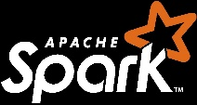
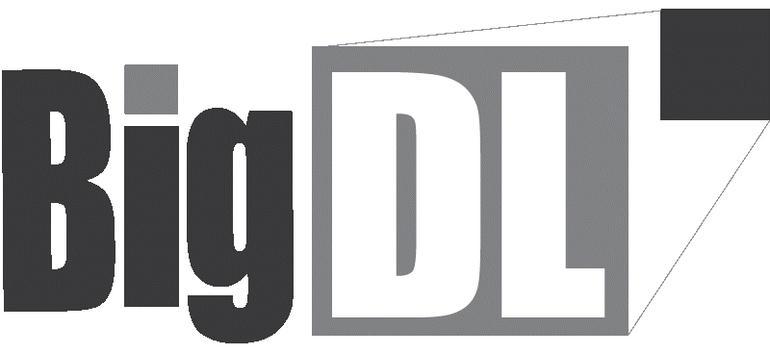
BigDL
Bringing Deep Learning To Big Data Platform
Distributed deep learning framework for Apache Spark*
Make deep learning more accessible to big data users
and data scientists
  Write deep learning applications as standard Spark programs
  Run on existing Spark/Hadoop clusters (no changes needed)
Feature parity with popular deep learning frameworks
  E.g., Caffe, Torch, Tensorflow, etc.
High performance (on CPU)
  Powered by Intel MKL and multi-threaded programming
Efficient scale-out
  Leveraging Spark for distributed training & inference
DataFrame
SQL
SparkR
Streaming
ML Pipeline
MLlib
GraphX
Spark Core
https://github.com/intel-analytics/BigDL
https://bigdl-project.github.io/
Notes:
That is why BigDL is developed and open sourced to bring deep learning to big data platform, here I mean spark ecosystem. It is distributed deep learning framework organically developed on Spark.

Slide 10
Analytics Zoo
Unified Analytics + AI Platform for Big Data
  Distributed TensorFlow, Keras and BigDL on Spark
Reference Use Cases | Anomaly detection, sentiment analysis, fraud detection, image generation, chatbot, etc.
Built-In Deep Learning Models | Image classification, object detection, text classification, text matching, recommendations, sequence-to-sequence, anomaly detection, etc.
Feature Engineering | Feature transformations for Image, text, 3D imaging, time series, speech, etc.
High-Level Pipeline APIs | Distributed TensorFlow and Keras on Spark Native support for transfer learning, Spark DataFrame and ML Pipelines Model serving API for model serving/inference pipelines
Backbends | Spark, TensorFlow, Keras, BigDL, OpenVINO, MKL-DNN, etc.
https://github.com/intel-analytics/analytics-zoo/
https://analytics-zoo.github.io/
Notes:
BigDL is the framework, it has layers, optimizers, criterions and all these fundamental elements to build deep learning applications. Analytics Zoo is on the top of that, it is an unified analytics plus AI platform. We support not just BigDL,we also support distubuted tensorflow, ….. In the Zoo, we have …

Slide 11
Analytics Zoo
Build end-to-end deep learning applications for big data
Distributed TensorFlow on Spark
Keras-style APIs (with autograd & transfer learning support)
nnframes: native DL support for Spark DataFrames and ML Pipelines
Built-in feature engineering operations for data preprocessing
Productionize deep learning applications for big data at scale
Pure Java or Python Model serving APIs (w/ OpenVINO support)
Support Web Services, Spark, Storm, Flink, Kafka, etc.
Out-of-the-box solutions
Built-in deep learning models and reference use cases
Notes:
Here is how it works. If you have a tensorflow model, we can train it in distributed way on spark. If you have string indexer to preprocess your features, you can put string indexer and nnestimater into ML Pipeline and fit it.

Slide 12
Distributed TensorFlow on Spark in Analytics Zoo
Data wrangling and analysis using PySpark
from zoo import init_nncontext
from zoo.pipeline.api.net import TFDataset
sc = init_nncontext()
#Each record in the train_rdd consists of a list of NumPy ndrrays
train_rdd = sc.parallelize(file_list)
.map(lambda x: read_image_and_label(x))
.map(lambda image_label: decode_to_ndarrays(image_label))
#TFDataset represents a distributed set of elements,
#in which each element contains one or more TensorFlow Tensor objects.
dataset = TFDataset.from_rdd(train_rdd,
names=["features", "labels"],
shapes=[[28, 28, 1], [1]],
types=[tf.float32, tf.int32],
batch_size=BATCH_SIZE)
Notes:
Here is one example that how we support distributed tensorflow on spark. The first step is to build a dataset.

Slide 13
Distributed TensorFlow on Spark in Analytics Zoo
Deep learning model development using TensorFlow
import tensorflow as tf
slim = tf.contrib.slim
images, labels = dataset.tensors
labels = tf.squeeze(labels)
with slim.arg_scope(lenet.lenet_arg_scope()):
logits, end_points = lenet.lenet(images, num_classes=10, is_training=True)
loss = tf.reduce_mean(tf.losses.sparse_softmax_cross_entropy(logits=logits, labels=labels))
Notes:
The second step is to build a model. We build lenet model, just give images and num_classes.

Slide 14
Distributed TensorFlow on Spark in Analytics Zoo
Distributed training on Spark and BigDL
from zoo.pipeline.api.net import TFOptimizer
from bigdl.optim.optimizer import MaxIteration, Adam, MaxEpoch, TrainSummary
optimizer = TFOptimizer.from_loss(loss, Adam(1e-3))
optimizer.set_train_summary(TrainSummary("/tmp/az_lenet", "lenet"))
optimizer.optimize(end_trigger=MaxEpoch(5))
Notes:
Finally, we build an optimizer and train it

Slide 15
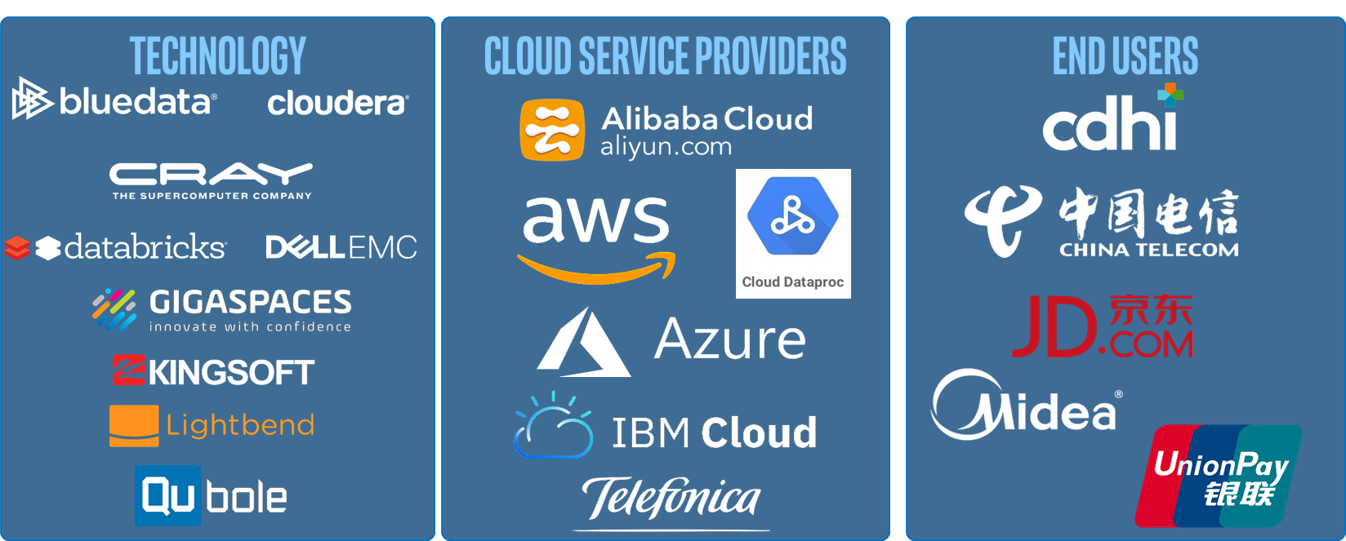
Building and Deploying with BigDL/Analytics Zoo
http://software.intel.com/bigdl/build
Not a Full List
Notes:
We have collaborated with a good number of customers all over the world to build applications. If you see our git and want to run deep learning applications on spark, please try our examples and usecases, if you have difficulty to build a POC, feel free to contact us.
Let’s focus on anomaly detection usecases.

Slide 16
Agenda
Why deep learning
Analytics Zoo/BigDL on Apache Spark
Analytics Zoo solution
    Baosight
    TravelSky
Notebook using public data
Takeaways

Slide 17
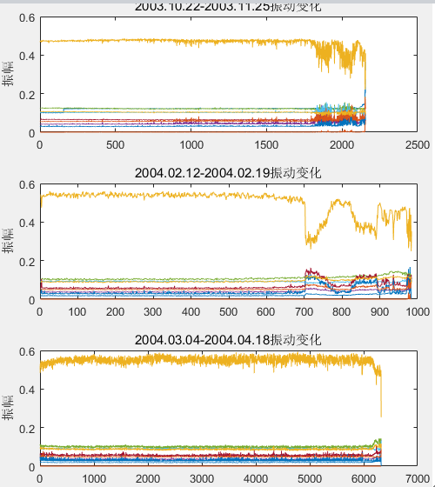
Anomaly Detection at Baosight
Massive amount of time series intelligent maintenance data for machines in manufactory industry
Save cost for regular maintenance
Give alarms before the machine fails
Unsupervised learning
Figure provided by Baosight
Notes:
Baosight has massive amount of time series intelligent maintenance data for machines in manufactory industry, like the right chart, vibrational data is collected at high frequencies. By eyes, we can tell at some point, the machine starts to function funny, and produce non-qualified devices. They usually do regular maintenance and when the machine fails, just replace it. This collaboration is to give alarms before the machine fails, so we can save cost for regular maintaenances, and for not producing non-qualified devices.

Slide 18
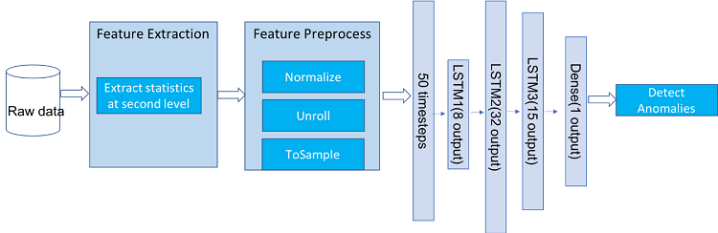
Analytics Zoo Solution
Notes:
We have deployed this end to end flow on spark. We read the raw data using spark, then we ….

Slide 19
Feature extraction and preprocess
val featureDF = loadData(sqlContext, inputDir)
Val normalized = Utils.standardScale(featured,…)
Val unrolled = AnomalyDetector.unroll(dataRdd, unrollLength)
val train = AnomalyDetector.toSampleRdd(unrolled.filter(x => x.index < cutPoint))
val test = AnomalyDetector.toSampleRdd(unrolled.filter(x => x.index >= cutPoint))
Notes:
We load data using spark, the process it. the raw data are sampled at 20 kHz, we extracted statistics of each second as features, including root mean square (RMS), kurtosis, peak, and energy values at each second.

Slide 20
LSTM-based AnomalyDetector
val model: AnomalyDetector[Float] = AnomalyDetector[Float](
featureShape = Shape(50, 3),
hiddenLayers = Array(8, 32, 15))
model.compile(
optimizer = new RMSprop(),
loss = MeanSquaredError[Float](),
metrics = List( new MAE[Float]()))
model.fit(trainRdd, batchSize, nbEpoch)
Dense(1 output)
LSTM3(15 output)
LSTM2(32 output)
LSTM1(8 output)
50 timesteps
Notes:
Then we define a lstm-based anomaly detector. In the middle, we have 3 layers of LSTM, the input is 50 timesteps of features.

Slide 21
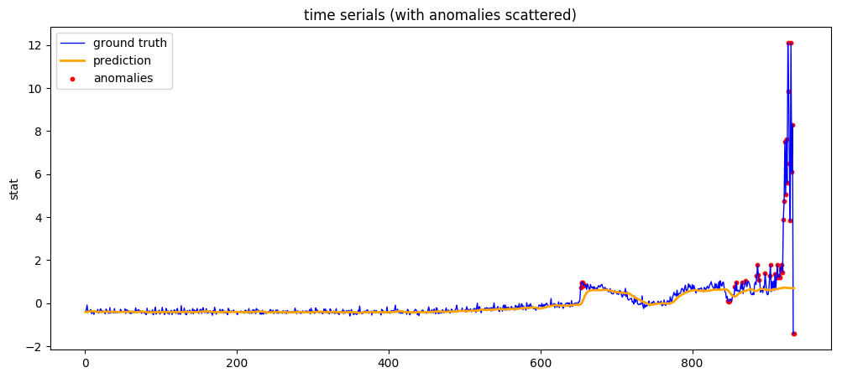
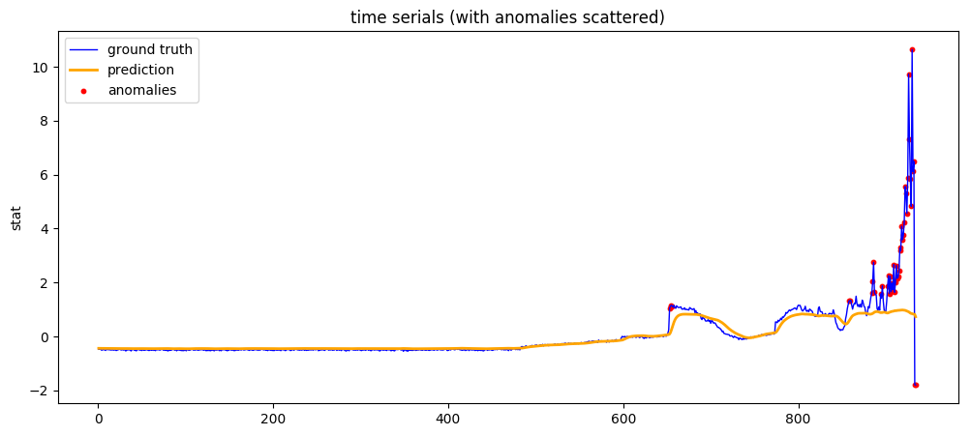
Results
val predictions = model.predict(testRdd)
val yPredict: RDD[Float] = predictions.map(x => x.toTensor.toArray()(0))
val yTruth: RDD[Float] = testRdd.map(x => x.label.toArray()(0))
val anomalies = AnomalyDetector.detectAnomalies(yTruth, yPredict, 50)
https://software.intel.com/en-us/articles/lstm-based-time-series-anomaly-detection-using-analytics-zoo-for-apache-spark-and-bigdl
Notes:
Anomalies are defined when the next data points are distant from RNN predictions.

Slide 22
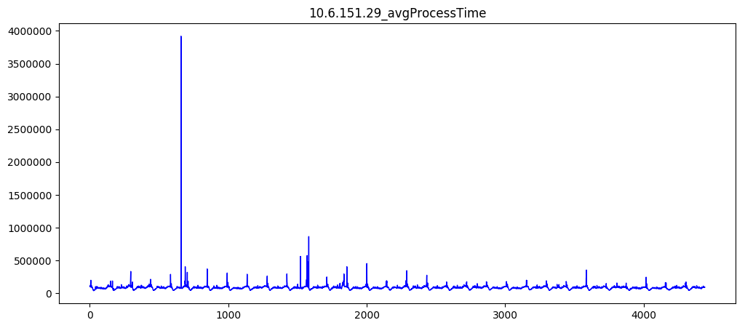
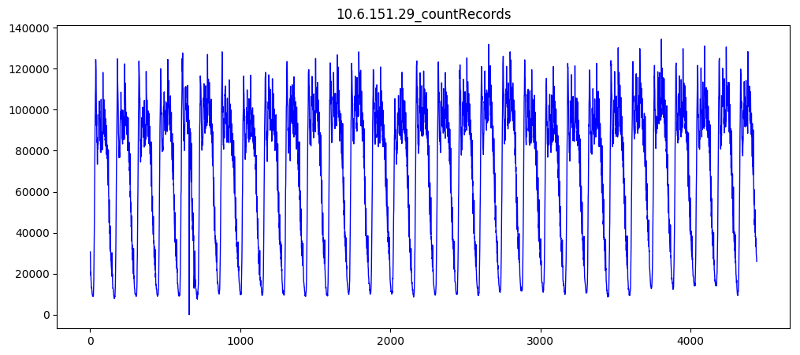
TravelSky Anomaly Detection
Logs of servers, databases, etc.
Save cost for monitoring and predictive maintenance
Unsupervised learning
Notes:
To detect if somebody is attacking the server or other anomalies.

Slide 23
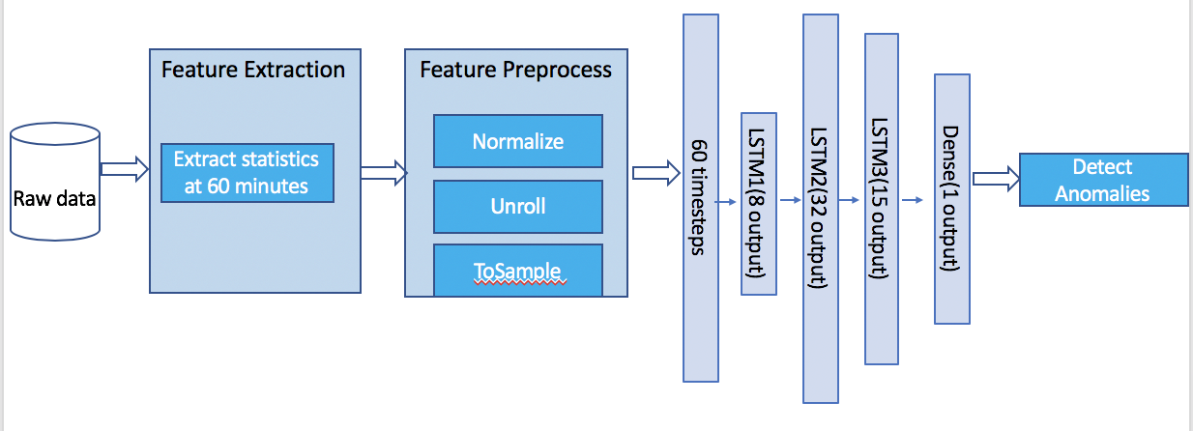
Analytics Zoo Solution
Notes:
We built a similar solution. The difference is feature extraction, Count of Records, Distinct remotes, Average process time, for each 10 minutes. Build an anomaly detector model, use 60 steps to predict next time step.

Slide 24
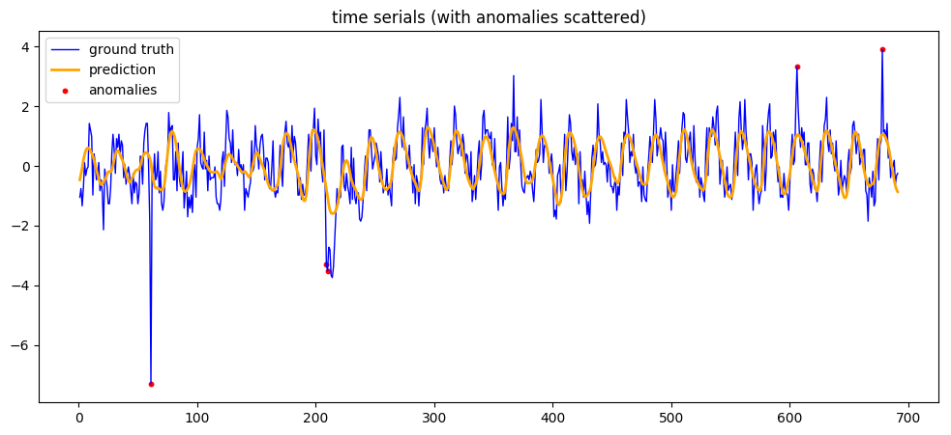
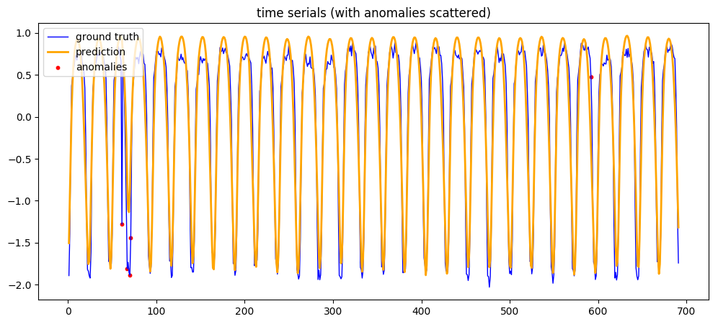
Results
val predictions = model.predict(testRdd)
val yPredict: RDD[Float] = predictions.map(x => x.toTensor.toArray()(0))
val yTruth: RDD[Float] = testRdd.map(x => x.label.toArray()(0))
val anomalies = AnomalyDetector.detectAnomalies(yTruth, yPredict, 50)

Slide 25
Timeseries Anomaly Detection on public data
Notebook:
https://github.com/intel-analytics/analytics-zoo/blob/master/apps/anomaly-detection/anomaly-detection-nyc-taxi.ipynb

Slide 26
Takeaways
Analytics Zoo/BigDL integrates well into customers’ existing Spark ETL and machine learning platform
Analytics Zoo/BigDL scales with time series data
LSTM-based DNNs capture anomalies for multiple use cases
Feature extraction still matters
Anomaly detection of time series would likely to play a key role in the use cases such as monitoring and predictive maintenance.
Notes:
These functionalities and solutions - for example collecting and processing massive time series data (such as logs, sensor readings) -and the application of DNN to learn the patterns and predict the expected values and identify anomalies, are critical for many emerging smart systems, such as industrial, manufacturing, IoT, and so on. Anomaly detection of time series would likely to play a key role in the use cases such as monitoring and predictive maintenance.

Slide 27
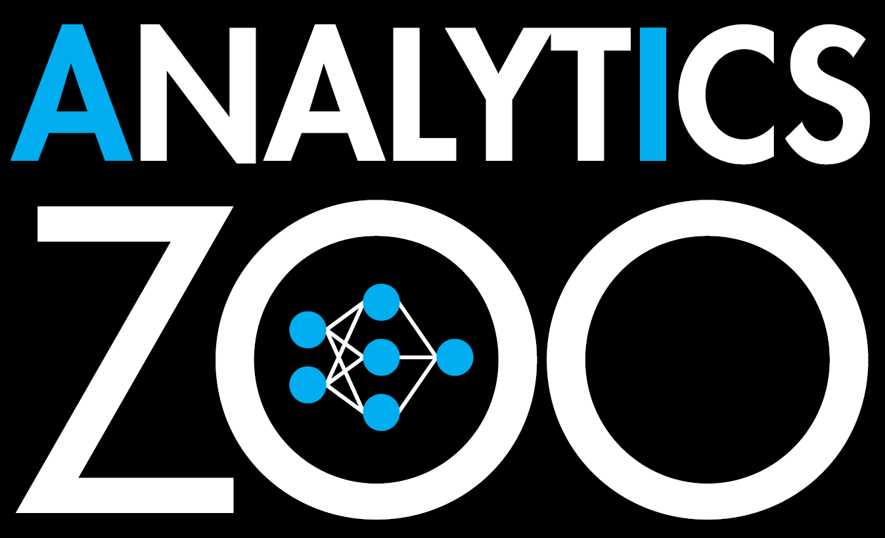
Unified Analytics + AI Platform
Distributed TensorFlow, Keras and BigDL on Apache Spark
https://github.com/intel-analytics/analytics-zoo
Notes:
This is github of our analytics Zoo, you can find more examples, use cases, detail implementations. Do not forget to star it.

Slide 28
Legal Disclaimers
Intel technologies’ features and benefits depend on system configuration and may require enabled hardware, software or service activation. Learn more at intel.com, or from the OEM or retailer.
No computer system can be absolutely secure.
Tests document performance of components on a particular test, in specific systems. Differences in hardware, software, or configuration will affect actual performance. Consult other sources of information to evaluate performance as you consider your purchase. For more complete information about performance and benchmark results, visit http://www.intel.com/performance.
Intel, the Intel logo, Xeon, Xeon phi, Lake Crest, etc. are trademarks of Intel Corporation in the U.S. and/or other countries.
*Other names and brands may be claimed as the property of others.
© 2019 Intel Corporation

Slide 29
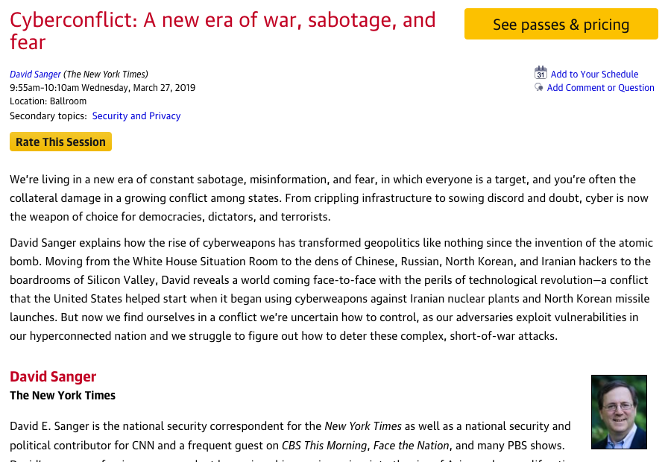
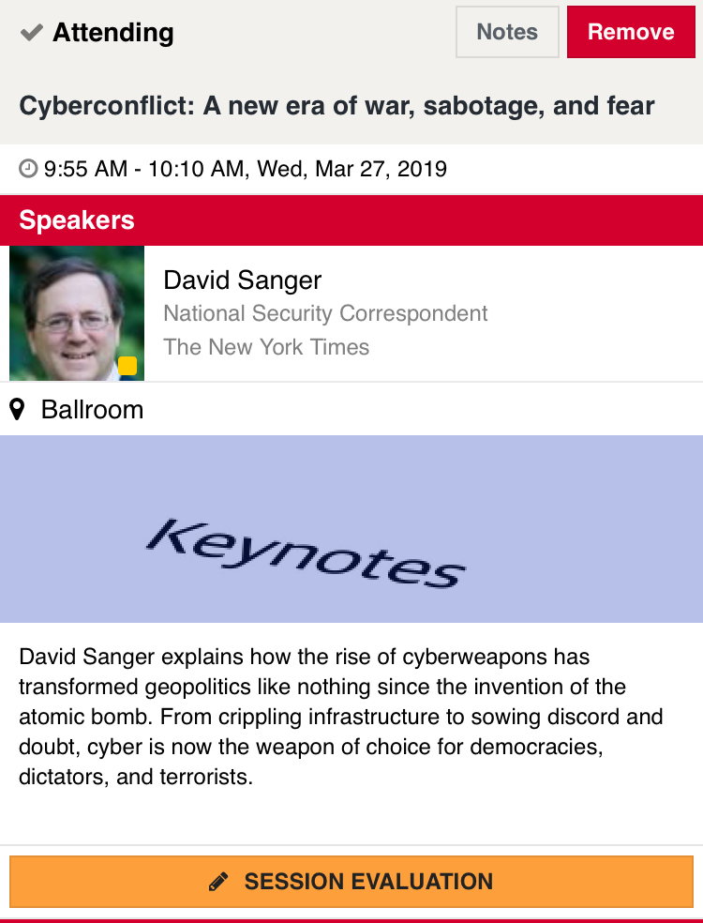
Rate today ’s session
Session page on conference website
O’Reilly Events App

